Slide 1
L.A Criminal Activity
Analysis
PRESENTED BY LAW AND DISORDER
Ettione C. Stuckey II |Mario Avila | Chi Asangwe

Slide 2
Table of contents
01
Overview
02
Hosting Data Lake
03
Setting up AWS Glue
04
Setting up AWS Redshift
05
Challenges
06
Demo/Questions

Slide 3
Overview
01

Slide 4

Introduction
Chief of police, Jay L. Thyme has employed our group of data scientist to help make more efficient use of his L.A police force. He’s asked us to analyze police reports in la and provide detailed insights on the types of crimes being committed across the city.

Slide 5
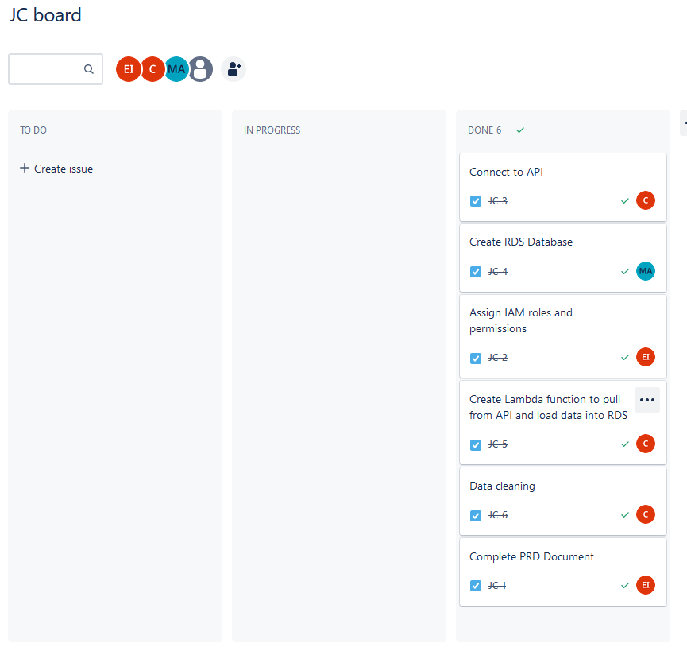
Team Communication
Our team chose to use a Jira board to allocate tasks, and held daily stand up meetings to ensure that we are hitting our checkpoints on time with Ettione as our SCRUM master.
Notes:
Creating our cluster was as easy as taking the serverless free trial and making it. You can see the layout of our cluster as shown in the query editor. You can see the contents of the jump-capstone database, but that actually isn’t the database we are working with. There is a handy option in the query editor to create a database using the AWS Glue Catalog we just created. The thing is, I couldn’t exactly figure out how to query from it. After a couple of failed queries, we decided to make one from scratch.
Next Slide

Slide 6

Where are we getting the data from?

Slide 7
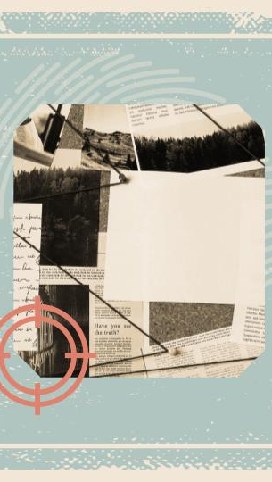
L.A Crime API
By using the L.A Crime Data API, we were able to pull live data in the for of a JSON file in order to perform our analytics and build our database.

Slide 8
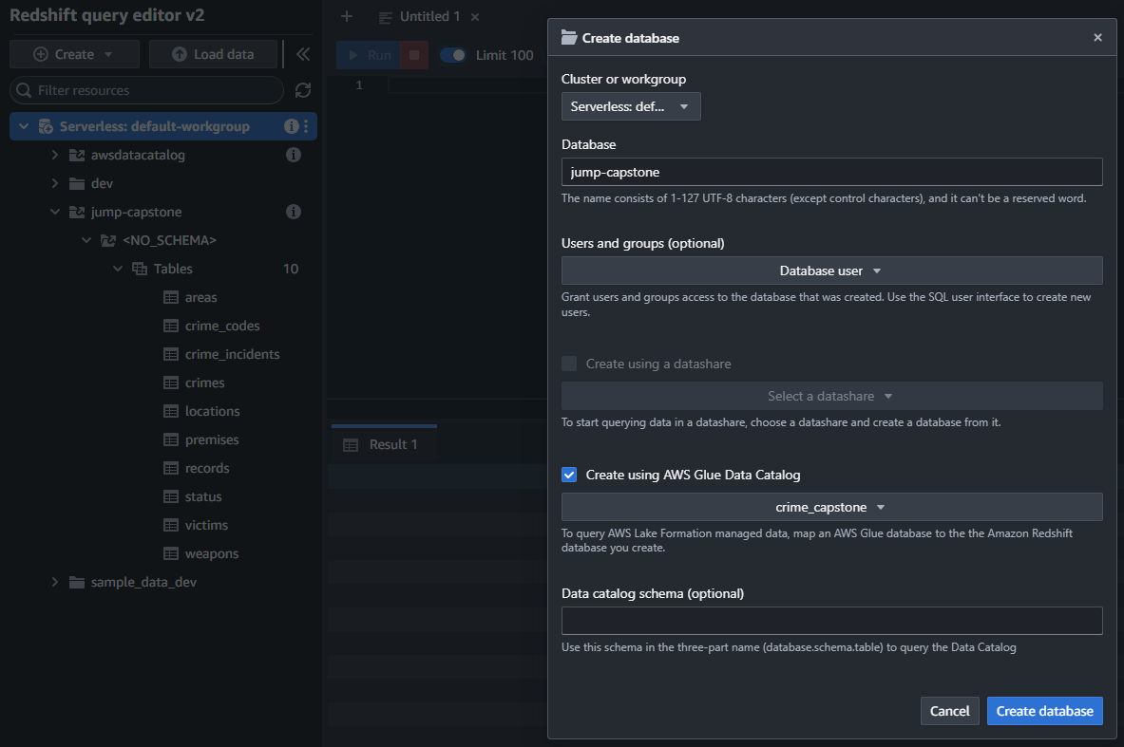
REDSHIFT CONFIGURATION
Notes:
Creating our cluster was as easy as taking the serverless free trial and making it. You can see the layout of our cluster as shown in the query editor. You can see the contents of the jump-capstone database, but that actually isn’t the database we are working with. There is a handy option in the query editor to create a database using the AWS Glue Catalog we just created. The thing is, I couldn’t exactly figure out how to query from it. After a couple of failed queries, we decided to make one from scratch.
Next Slide

Slide 9
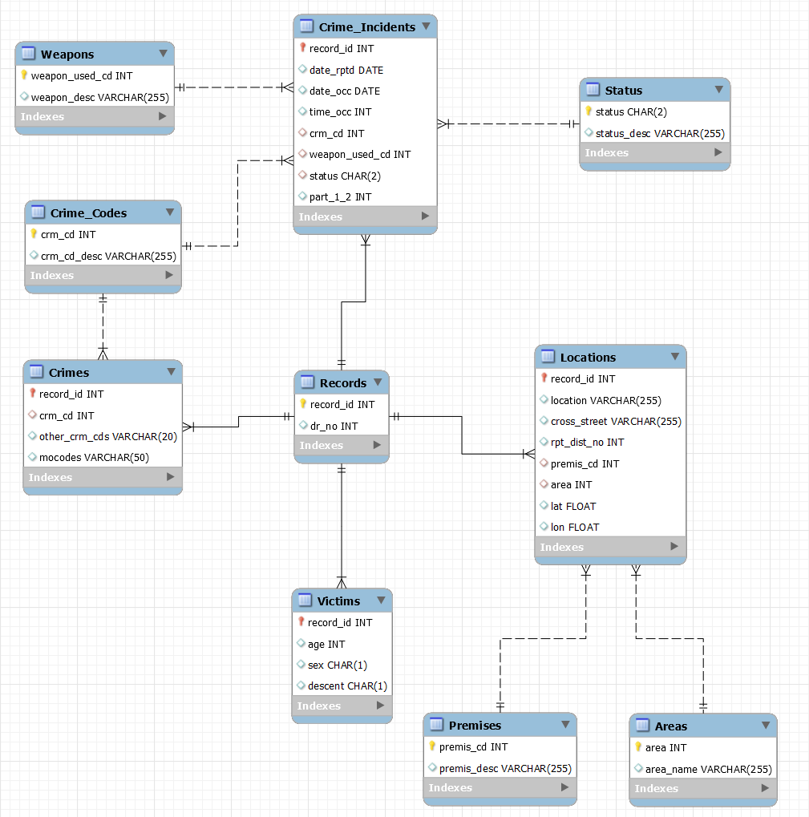
DATABASE SCHEMA
Notes:
We have our records table which is connected to the crime, the crime_incidents, Location, and Victims. From there, we can find more details about the incident like the status, or weapons used and how they relate to each other.

Slide 10
Chi Asangwe
Ettione Stuckey II
SETTING UP IAM
Mario Avila
NEEDS ACCESS TO AWS GLUE AND REDSHIFT
NEEDS ACCESS TO EC2 AND S3
BEFORE WE CAN GET STARTED USING OUR AWS RESOURCES, WE NEED TO ASSIGN USERS, GROUPS AND PERMISSIONS.
NEEDS ACCESS TO AWS GLUE, REDSHIFT, AND LAMBDA

Slide 11
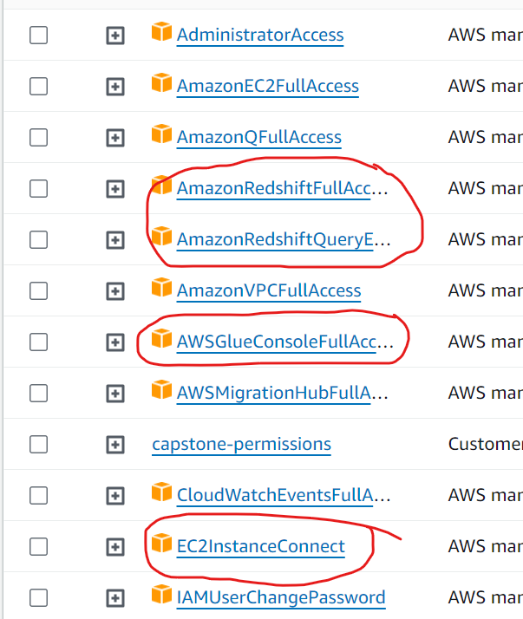
AWS Glue Full Access
AWS Redshift Full Access
EC2 Instance connect
Key IAM Policies

Slide 12
Hosting the Data Lake
02
WITH AWS S3
Notes:
So we decided to go with tier 2 and use AWS for our data pipeline. We started by setting up an S3 bucket and prepared it to be our data lake.
Next Slide

Slide 13
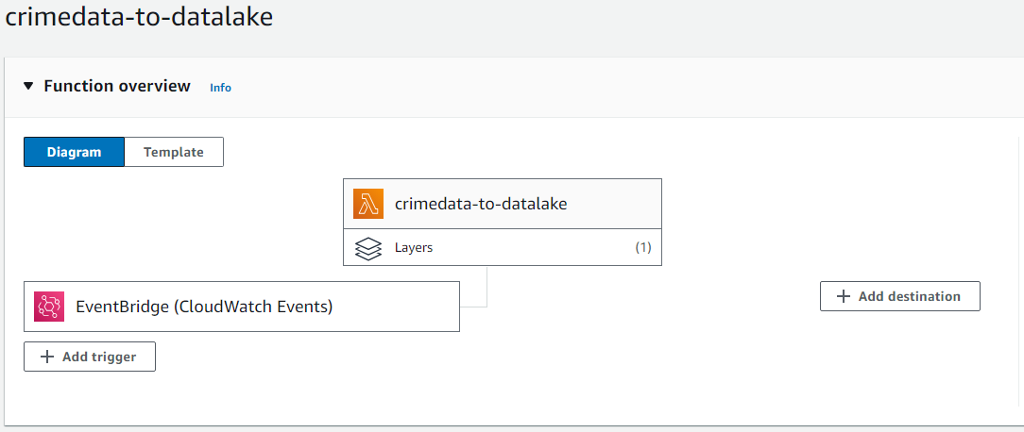
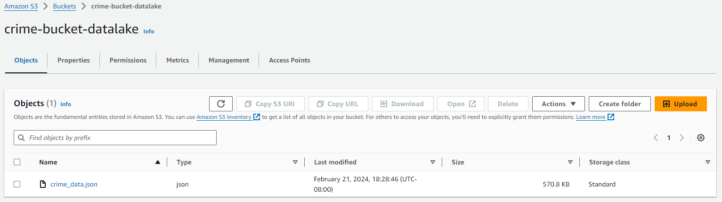
USING LAMBDA AND CLOUDWATCH
TO UPLOAD DATA TO S3 BUCKET
Notes:
We already had some practice programmatically accessing S3 buckets, so it was easy enough to create a lambda function to gather data from an API and write it into our bucket. We did do some data cleaning in the lambda function like dealing with outliers and invalid data since we were used to doing it manually, even though there are tools to help with the process. Also, since we are accessing a live dataset, we added a cloudwatch event to invoke the lambda function weekly. The dataset actually switched to bi-weekly updates because LAPD is having some issues posting their data, but it has been updated this month so we know it’s still regularly maintained.
Next Slide

Slide 14
Setting up AWS Glue
03
For Cataloging Data and ETL Jobs
Notes:
Since we have our datalake set up, it is time to structure our data with AWS Glue.
Next Slide

Slide 15
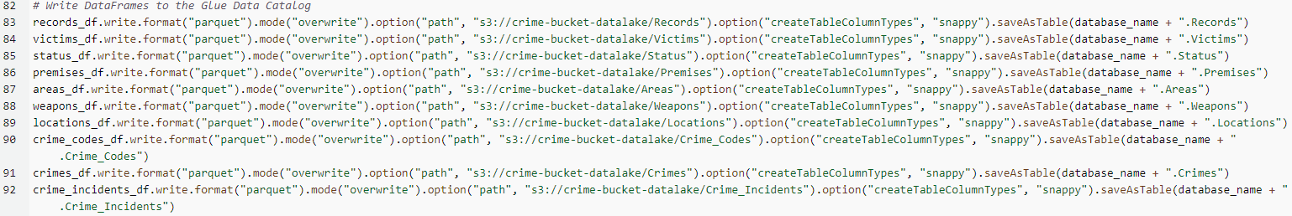
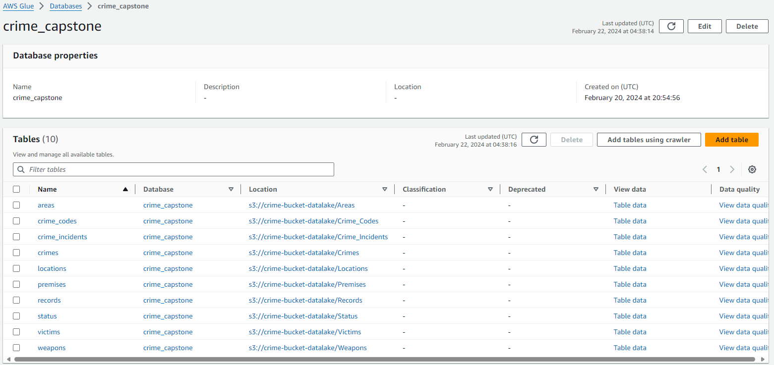
CONNECTING TO
AWS GLUE
Notes:
It was our first time using AWS Glue, so it took a bit to get used to how it works. It’s purpose was to catalog our data into the appropriate tables. We did most of our cleaning in the lambda function, but since we are separating the data right here, we had to get rid of duplicates and null values. That script up top is attached to an ETL Job, which can be scheduled, preferably after the lambda function has been invoked to gather the API’s data. AWS Glue doesn’t exactly hold data, which is why you can see that it stores the catalog information in our S3 Bucket, but you can see how the tables are set up in it’s interface.

Slide 16
04
Setting up AWS Redshift
Cloud-based Data Warehousing
Notes:
Okay, so we still aren’t done talking about AWS Glue, since we need Glue in our setup of Redshift, but we still have to create our cluster before running any operation.
Next Slide

Slide 17
REDSHIFT CONFIGURATION
Notes:
Creating our cluster was as easy as taking the serverless free trial and making it. You can see the layout of our cluster as shown in the query editor. You can see the contents of the jump-capstone database, but that actually isn’t the database we are working with. There is a handy option in the query editor to create a database using the AWS Glue Catalog we just created. The thing is, I couldn’t exactly figure out how to query from it. After a couple of failed queries, we decided to make one from scratch.
Next Slide

Slide 18
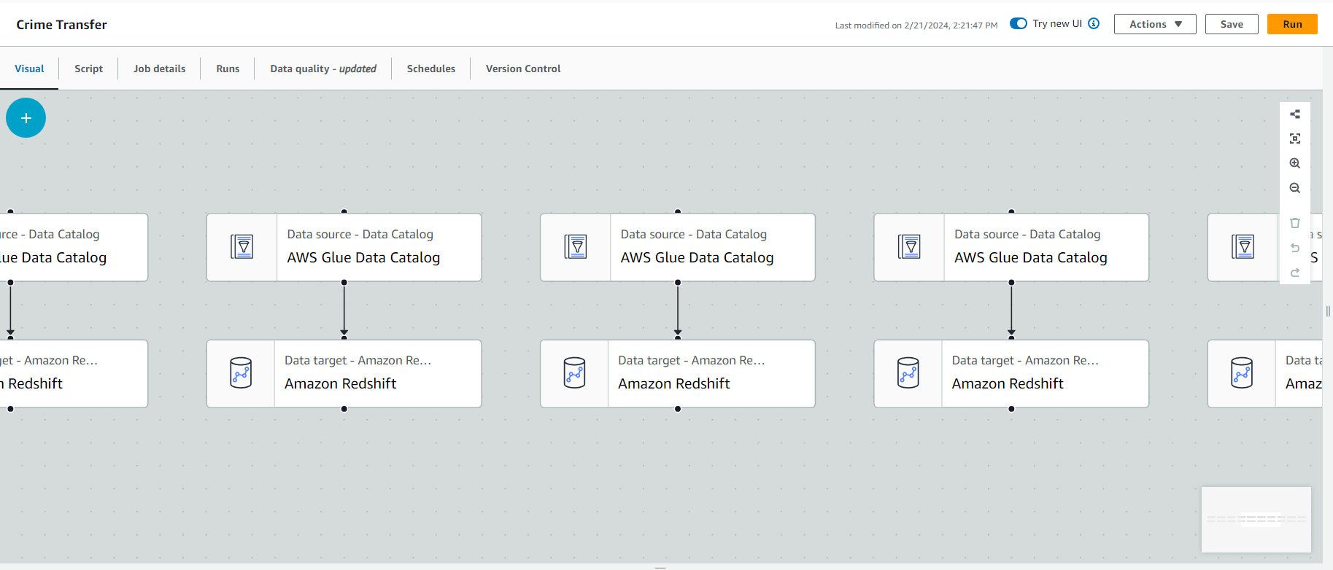
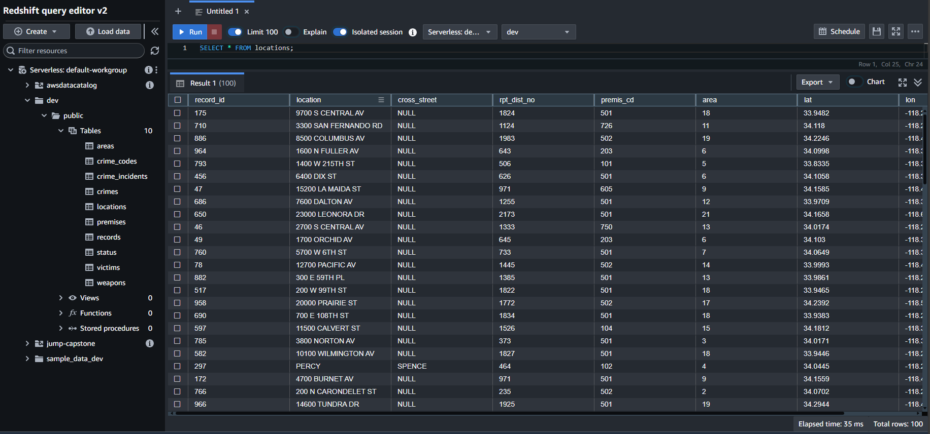
AWS GLUE TO AWS REDSHIFT
Notes:
Since we made the tables from scratch, we needed to use AWS Glue to import it’s catalog’s data into the Redshift database. It was easy to set up an ETL job for it. Just a bit annoying since you can only select one table to transfer data from at a time. It is convenient though. As mentioned before, you can schedule ETL jobs, automating the process of structuring the data and importing it into Redshift.
Just to note, our actual database is named dev. It was just to leave the default options on and dev is considered a reserved word. Not quite sure with that means, but we were able to make queries just fine when we made our database from scratch.
Next Slide

Slide 19
Challenges
05
A FEW OBSTACLES WE HAD TO OVERCOME

Slide 20
Challenge
Solution
AWS Glue and AWS Redshift was new to us all.
We had to do our research on what each service does and configure them to our needs.

Slide 21
Challenge
Solution
When importing tables from AWS Glue to AWS Redshift, All of them but one was transferred successfully
We did the data cleaning on the initial unstructured data, so we forgot to take care of nulls and duplicates when structuring the data. You can’t have a null Primary key!
Notes:
As for the table in question, it was our weapons table. Not every crime has a weapon involved, and I didn’t realize that since I was focused on getting the data loaded in the first place.

Slide 22
Challenge
Solution
While writing our scripts for visualizations and analytics, we noticed that the attributes for the time that a crime occurred were all in 2020. This is an issue considering this data should be from 2020 to 2023 onward.
we saw this as a data entry error, and decided to move forward with our analytics using the date that the crime was reported. This way, we could get a better grasp of when crimes were actually happening.

Slide 23
Questions?
06
Click Here to view our Analytics

